Slide 1




SHINING BRIGHT
with a UK cleaning Franchise

Slide 2




1st or 2nd income
All properties need cleaning
Commercial
Sanitization
Domestic
TRUE CLEANING EXPERTS
Domestic cleans are always popular and in high demand. Your clients will usually request either weekly, fortnightly or monthly regular cleaning services. Clients can range from busy professionals to parents needing help.
CONTRACT WORK CAN BE PROFITABLE £
Almost ALL business’s want regular office, or premise cleans. Usually you would provide a set price for a pre-agreed cleaning routine / plan. You would simply follow this upon every visit and for the same regular money as agreed.
Commercial Workspaces
Why not let your Bebo franchise offer this what can be very profitable service. High-touch surfaces especially in offices and work places like telephones & PC's etc should be cleaned and disinfected often, based
on level of use.

Slide 3

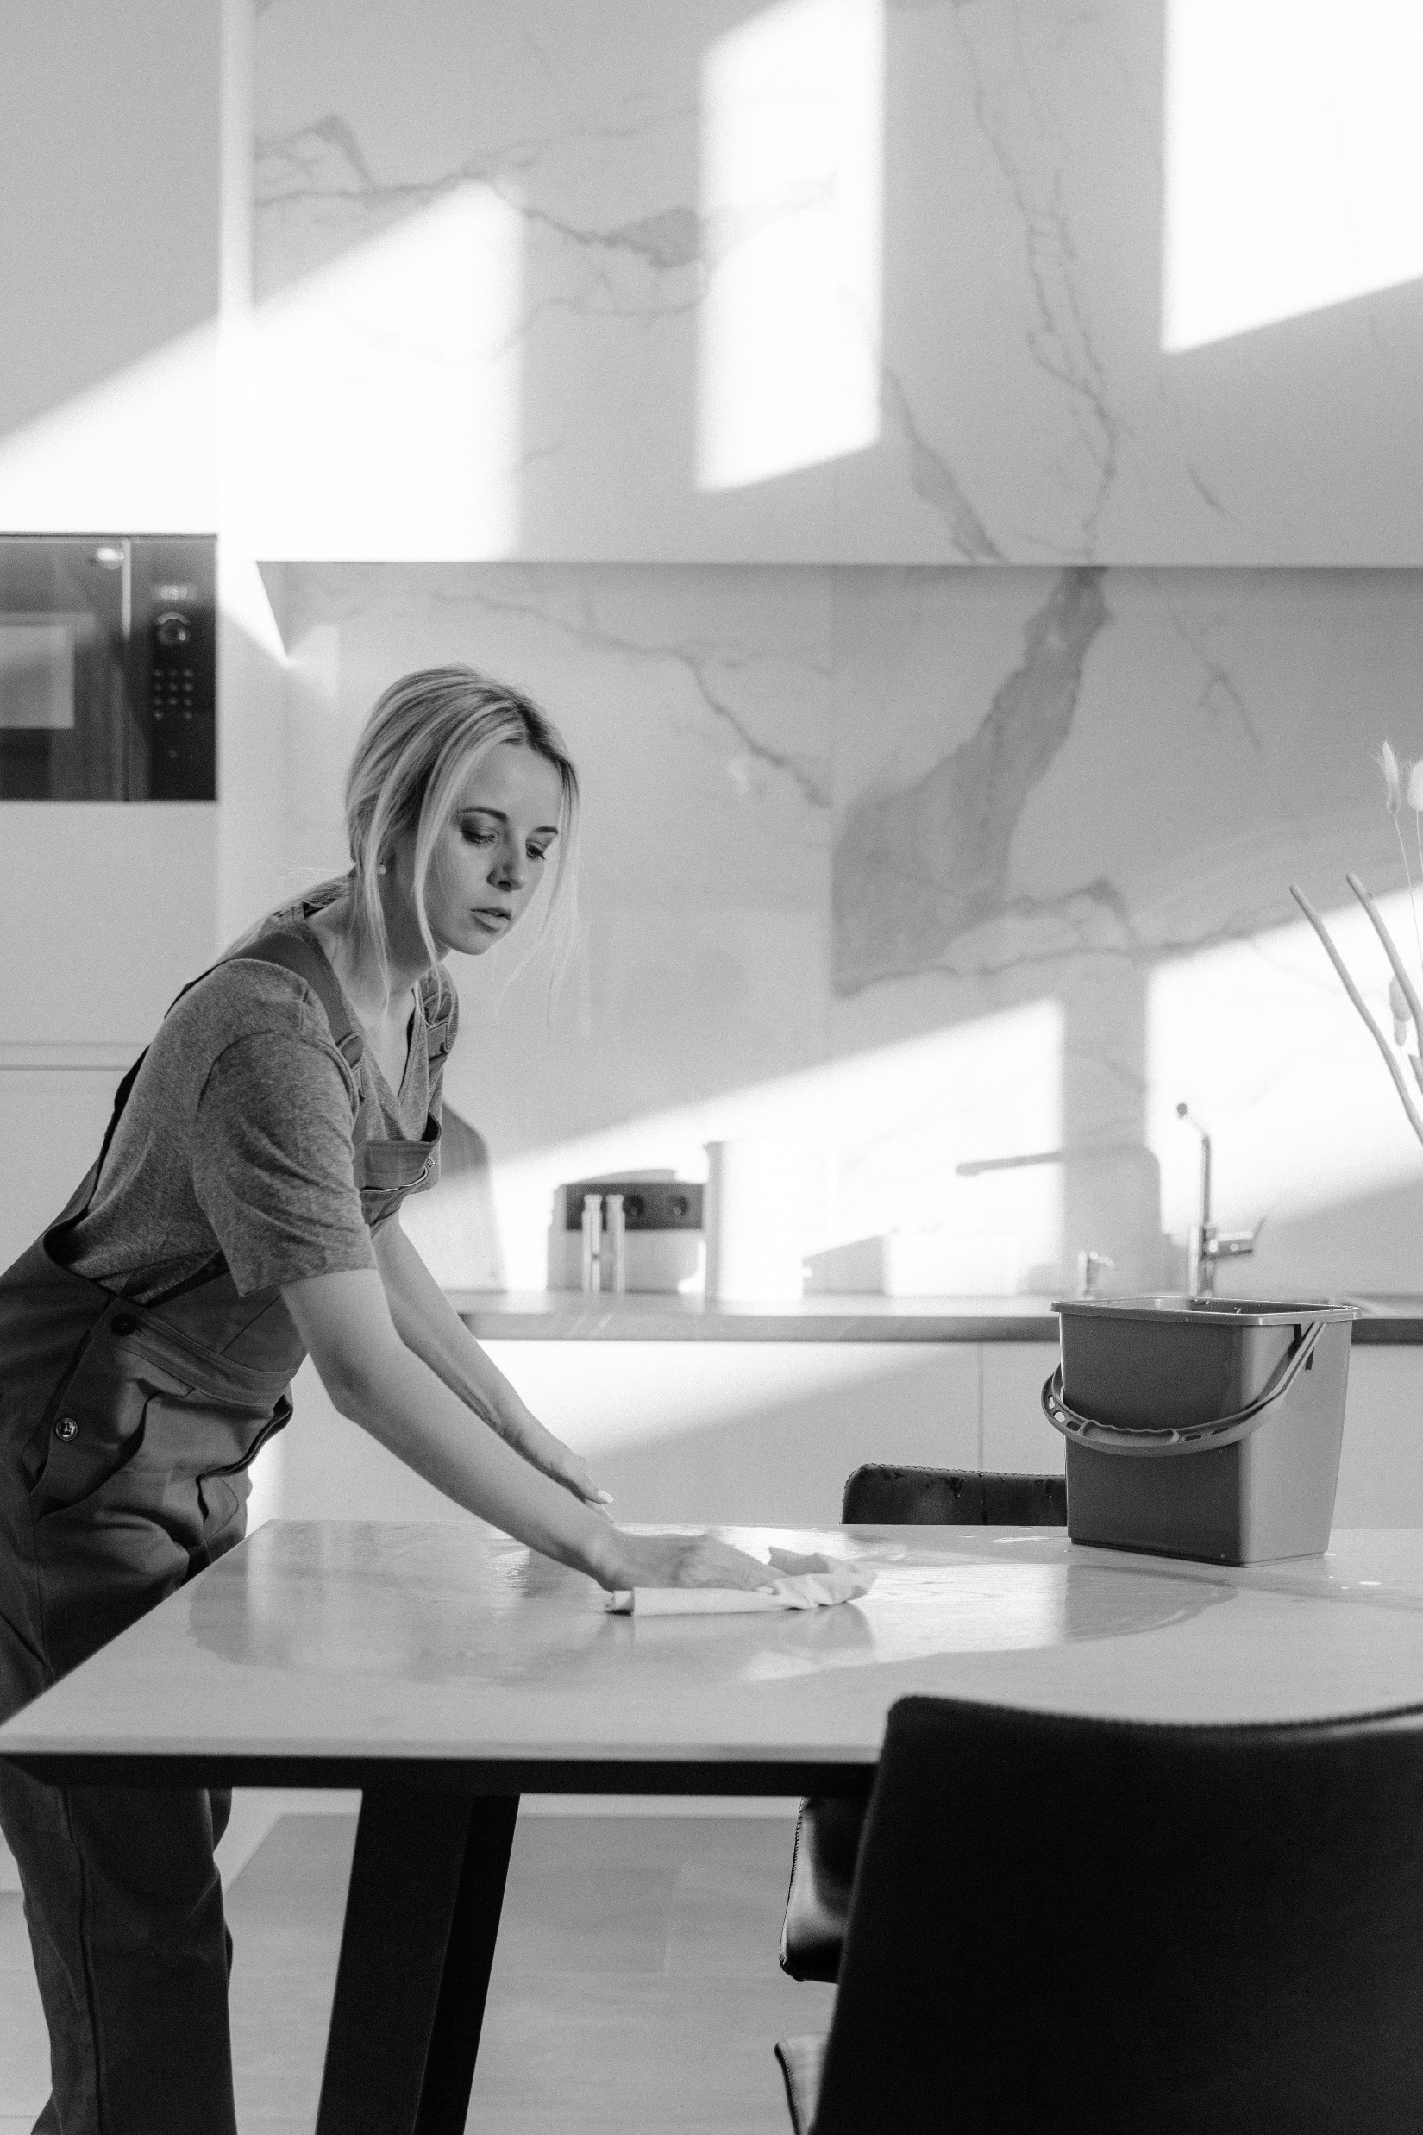
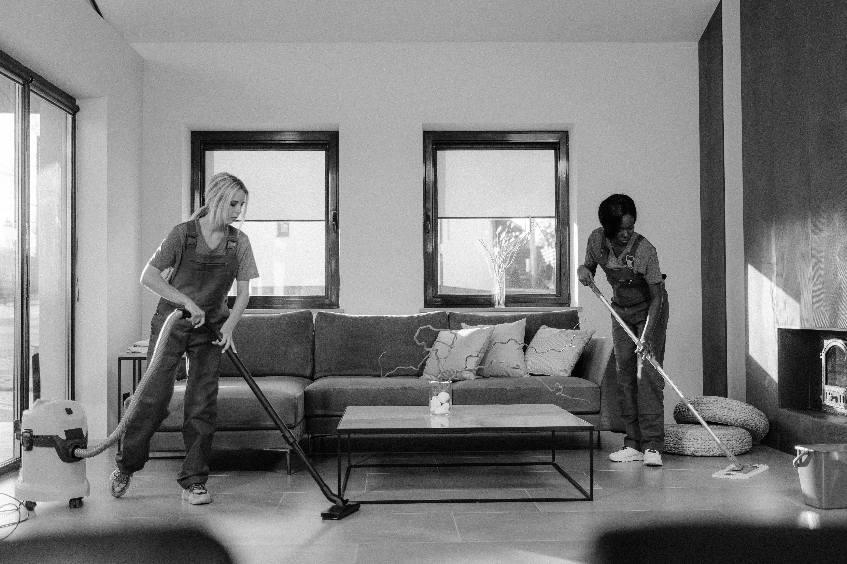


Bebo cleaning franchise
With 'Bebo', you will be fully set-up in your cleaning business within 7 days. Everything will be fully customized to you and your business (your chosen geo graphical area for work, contact mobile and name to use etc)
Work by Yourself
Work in a Partnership
Team Manager
A lot of our Bebo franchise owners choose to work alone either part or full time. In essence your franchise allows you to be in charge of your own workflow and diary + don't forget you get paid all monies 100% direct to you.
Partnerships are great if you want to perhaps build your 'Bebo' franchise into a bigger business. Additionally, the ability to share on driving and varying rotas. The opportunity to take on larger cleaning jobs is also a +plus
‘If you do not want to be 'HANDS ON' directly carrying out the cleaning jobs then you can opt to operate your business as a TEAM MANAGER. Simply source subcontract cleaners and then oversee their workload and profit handsomely.

Slide 4


4 easy steps to make money
Job Enquiry
Estimates
01
02
All work leads go DIRECT to you and your local Bebo cleaning franchise in a number of ways. In any business, leads & all job opportunities are generated from a multi-faceted approach
Local businesses & private clients will love your cleaning service. When you provide professional looking estimates, you should find that GO-AHEAD conversations are increased.
Paid DIRECT
Make Money
03
04
All monies for each job will flow direct to you. ‘Bebo’ head office do not get involved with this. You will also never pay royalty or any commission % on
Having a attractive brand will give you a distinctive edge advantage over other cleaning companies in your area. Being the number 1 service provider gets easier with BEBO.

Slide 5


Join our ‘Bebo cleaning’ franchise network

Slide 6


Bebo cleaning
“

Slide 7

Financials Layout
‘It’s affordable with a BEBO franchise’
£39p/m
£299
£0
£
Bebo charges only a small flat £39 p/m in lieu of royalty/commission + goes towards the upkeep of all your business Bebo assets.
Bebo charges a design & set up fee of only £299 that gets you customized LIVE in business.
Never pay royalty or commission 0%. £0
Just your home office / normal small business running costs typically incurred with running any business.

Slide 8

Timeline To Join & be LIVE
From placing your order & paying £299 you will receive an information sheet that collects specifics of what contact details + areas you want to offer your chosen services in etc.
Our business design team will craft & customize your very own unique ‘Bebo cleaning’ franchise. They do and create for you so much we are sure you will ‘Smile Forever’.
Day 1
Week 1
Each day our designers will be emailing your new dedicated business email. They will send you most elements daily as they create your business. They encourage you to look at, suggest a few tweaks and make final proofs.
After 7 working days your business will typically be fully customized & be complete. After final checks with you it will all be made ‘LIVE’.
Week 1
Day 8

Slide 9


Your future career & income is looking BRIGHT

Slide 10
SHINING STRONG
You receive so much with a ‘Bebo cleaning’ business that you need to take a LIVE look at what you will be receiving www.bebo.cleaning/included
www.bebo.cleaning

Slide 11


Questions?
Or JOIN now
info@bebo.cleaning
www.bebo.cleaning
07837 290257

